Slide 1

CS 533 INTRO TO DATA SCIENCE
Michael Ekstrand

Slide 2
TESTING ASSUMPTIONS

Slide 3

Learning Outcomes
Know the assumptions of linear models
Identify violations of assumptions regarding residuals
Photo by Austin Kehmeier on Unsplash

Slide 4
Linear Model Assumptions
Linearity — outcome and predictor have linear relationship.
Independence — observations are independent of each other
Normal errors — residuals are normally distributed
Equal variance — residuals have constant variance (called homoskedasticity; violation is heteroskedasticity)
Last three result in i.i.d. normal residuals

Slide 5
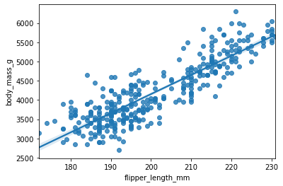
Linearity
Fundamental assumption – we wouldn’t run a linear model for things we think aren’t linear.
Scatter plot shows the line seems to fit.

Slide 6
Independence
Property of data collection
Not directly checkable
Commonly violated by:
Time series
Groups or common environments
Common environments
Repeated individuals
Solutions: correlated error models, hierarchical models, mixed effects models

Slide 7
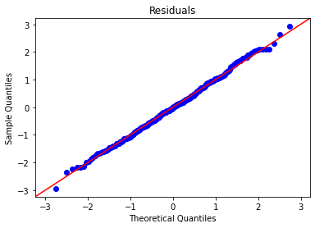

Normal Errors
Errors must be (approximately) normally distributed.
Check with a Q-Q plot of residuals.
Violations mean:
Line still fits
P-values and CIs are unreliable

Slide 8
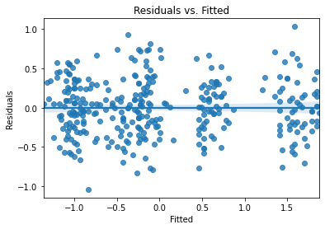
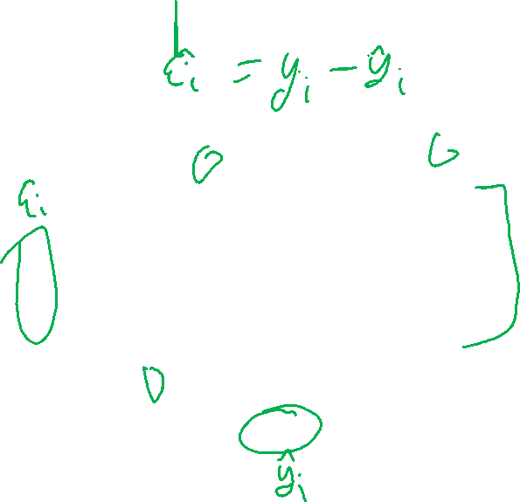
Equal Variance of Errors (homoskedasticity)
Residuals must have constant variance.
Check with residuals vs. fitted scatterplot or regplot.
Vertical positions should look like random noise.
Violation means model is failing to capture a systematic effect.

Slide 9
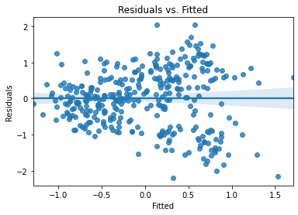
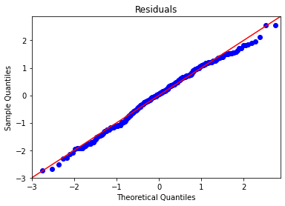

Heteroskedastic Errors

Slide 10
What to Do
Prediction? Might not matter.
Throw away the model – this might not work
Add, remove, or transform predictors
Transform outcome
Go to non-parametric, such as bootstraps or nonparametric regression (won’t have time for NPR)
Hierarchical or mixed-effects model

Slide 11

Wrapping Up
Linear models make four key assumptions necessary for inferential validity.
Plotting the residuals allows us to detect violations of some of them.
Photo by Neil Thomas on Unsplash

